Slide 1
From the Weissman Lab to Tibet
Robert Fox, MD., Ph.D.
Chairman of Rheumatology
Scripps Memorial Hospital and Research Institute
La Jolla, CA

Slide 2
Happy Birthday Irv

Slide 3
I was in Weissman lab until 1980
Arrived as arrogant MD-PhD (Harvard) and Chief Resident (Stanford)
Irv told me that if I listened to Labusch and Anne- that I might just learn enough to survive 2 years in his lab

Slide 4
But at the end of my time at Stanford in 1980, I was totally disgusted with the politics of universities
I had decided to quit universities and I had made plans to work on a remote part of the Navajo reservation with the public health service
On his own, Irv contacted his Frank Dixon and his cousin (Richard Lerner) at Scripps—so thank you again

Slide 5
So I decided to give research/clinical one more try
Scripps created the “Translational Research Fellow” position to interface the GCRC and the Research Institute
In addition, I worked with WHO (in China), Doctors without Borders (SARS in Singapore and 5N5 in Refugee Camps in Jordan),
With recombinant phage method, we made vaccines to Ebola from SLE spleens) with Dennis Burton

Slide 6
The work on preserving endangered herbs
About 10 years ago—we began working on a DNA bank in India with the Gates Foundation
But the herbs we needed were in Tibet at base of Himalyas

Slide 7
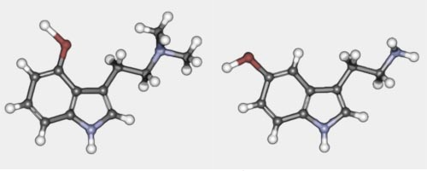
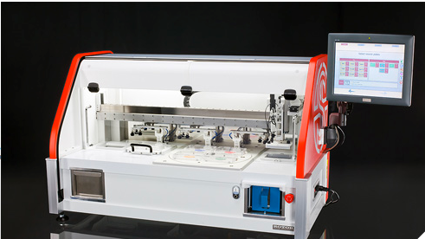
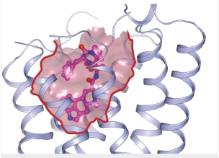
Screen for new drugs from herbal sources with Nicholau and Sharpless labs
A. Serotonin
B. Herbal analog of serotonin used in traditional medicine
C.
DD.
Crystal model of serotonin IB binding pocket used for screening
Robotic throughput screening

Slide 8
The medicinal plant genome is about 50 fold larger than human genome-and the medicinal compounds are complex
Evolution in the fast lane
Imagine borrowing a few genes from a lion to improve your night vision, sneaking a couple from a salmon to breathe underwater, and swiping one or two more from a salamander in case you need to grow back a finger.
Yes, it sounds crazy, because animals don’t normally swap genes. But plants do, even between species as different as humans and salamanders.

Slide 9
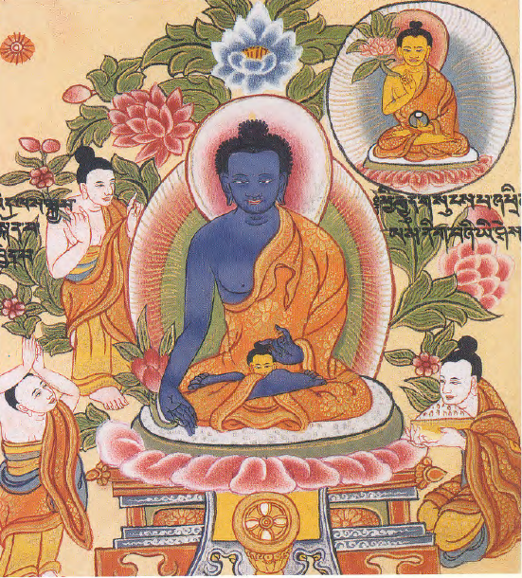
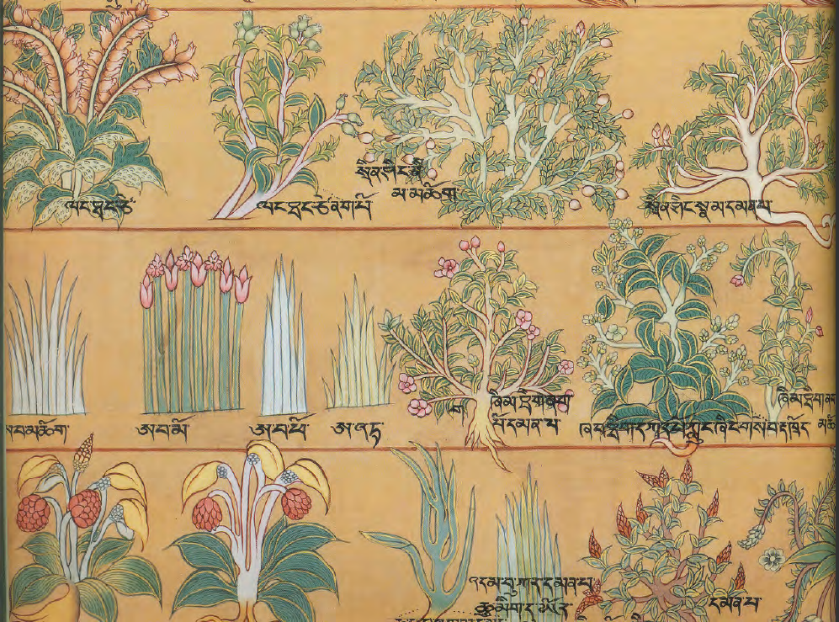
The “Medicine” Buddha uses specific plants Many are now going extinct due to global warming
These were some of the basic herbs that we needed to find based
On Ancient Manuscripts not yet destroyed by the Chinese
The Medicine Buddha

Slide 10
Tibet is controlled by China (like it or not)
Most of the endangered herbs are grown in Tibetal Buddhist Monasteries at the base of Himalayas
Since China was killing the Monks and destroying their books then, Tibetan buddhists were justifiably wary of the Chinese intentions
No Chinese were allowed on the expedition by the monks

Slide 11
Our Little Expedition to the Jade Valley
Thus, a group including an American physician (me),
4 ethnic Tibetan female nurses as interpreters for different dialects,
4 English botanists (who the Tibetans specified had to be gay), and
6 sherpa’s (carrying our equipment for DNA extraction or cell freezing equipment) started up the “Silk Road”

Slide 12
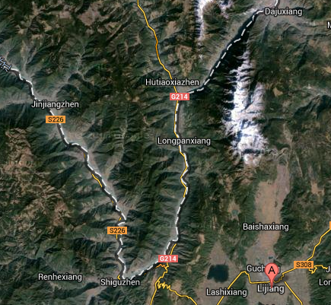
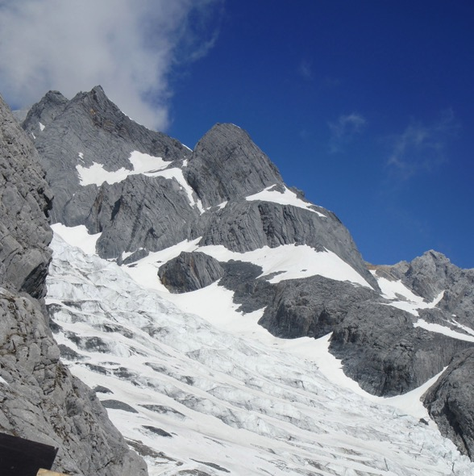
Our Destination
Jade Mountain Valley

Slide 13
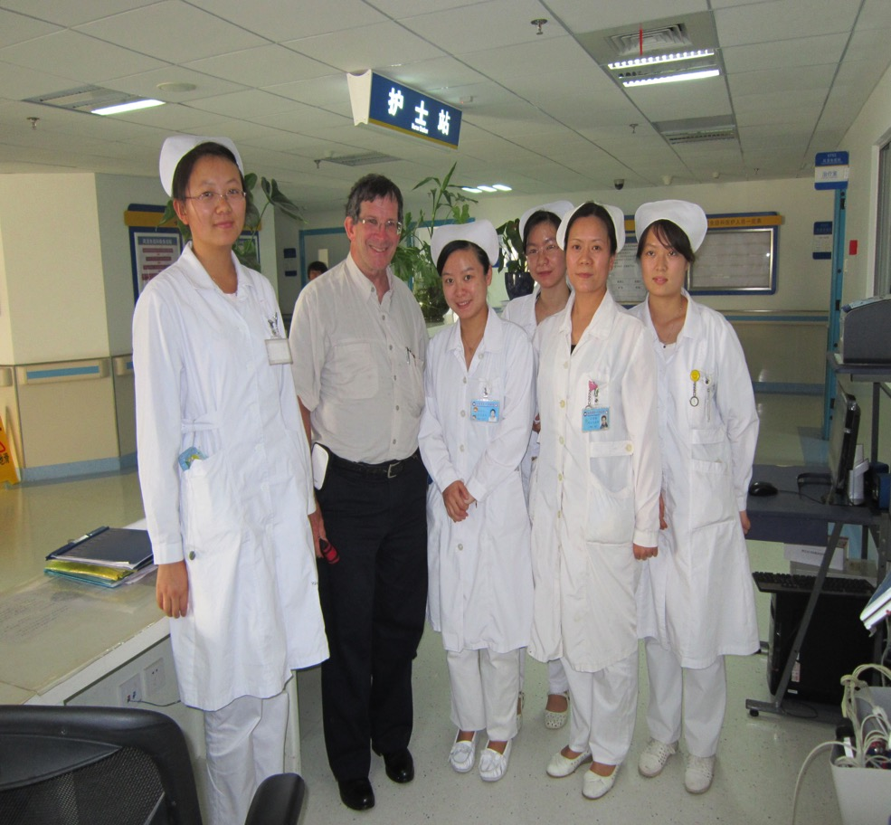
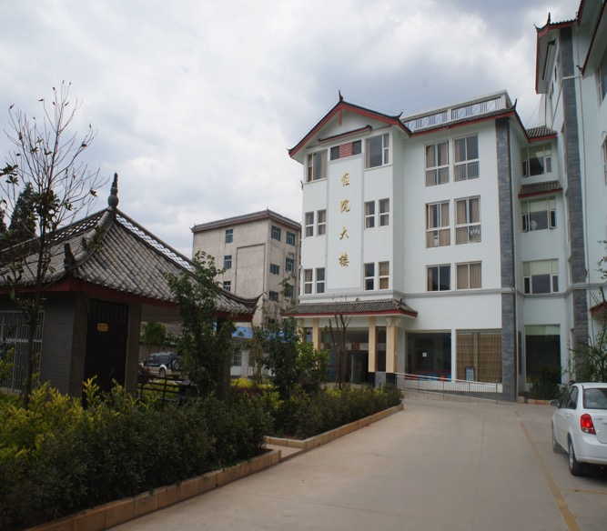
We started at the Traditional Medicine Hospital at Hutiox and
they were our interpreters

Slide 14
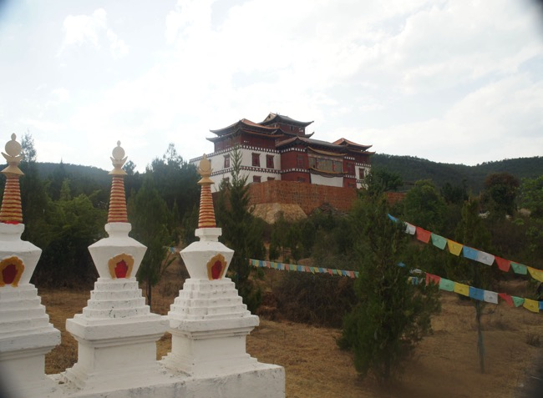
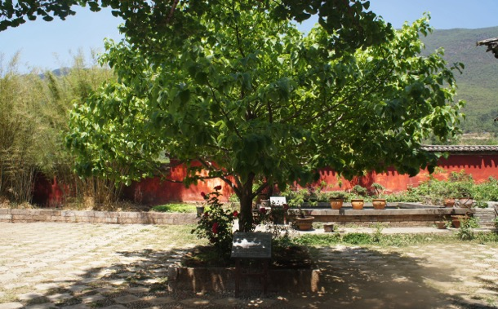
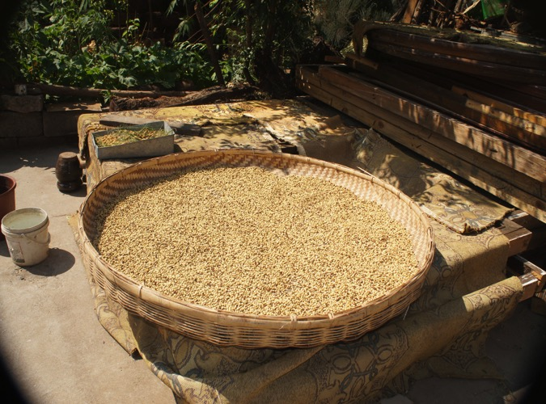
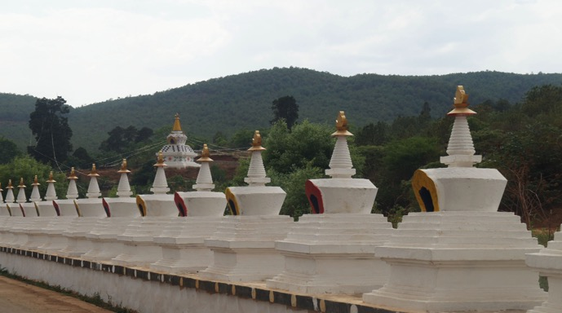
Typical Buddhist Monastary appears out of a mountainside and its medicinal garden
Slide 13

Slide 15
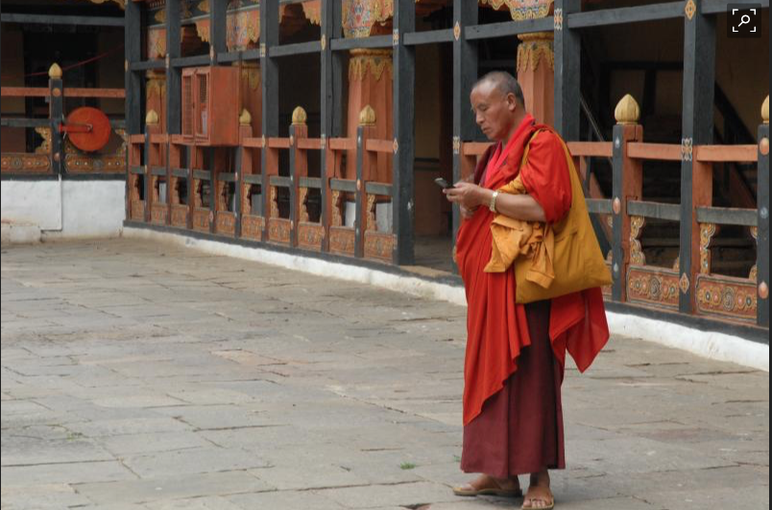
A Monk would meet us at entrance and had to ask permission of Head Abbot to let us enter. I loved the cell phones

Slide 16
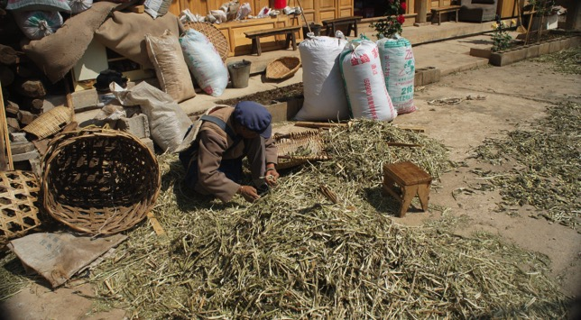
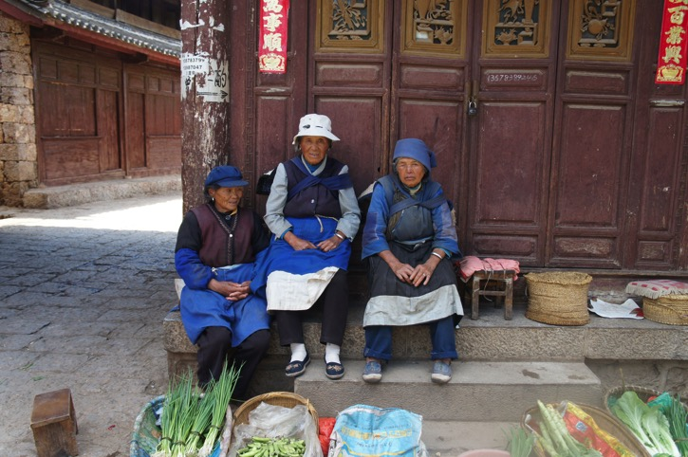
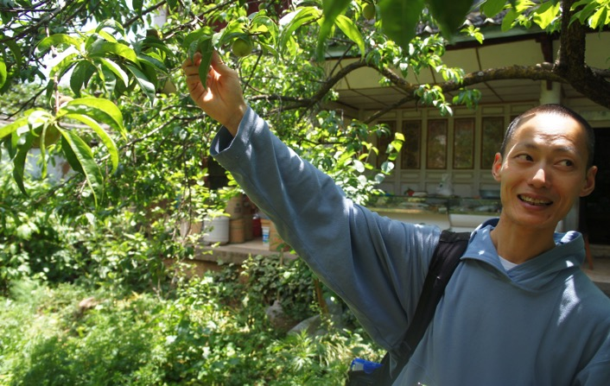
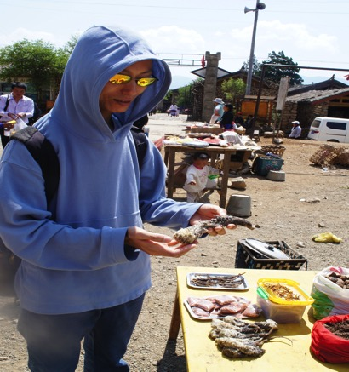
Most of the herbs are collected and seeds sorted by local women
One of our botanists finding seed pods
Various insect parts
Are also collected
For the medicines

Slide 17
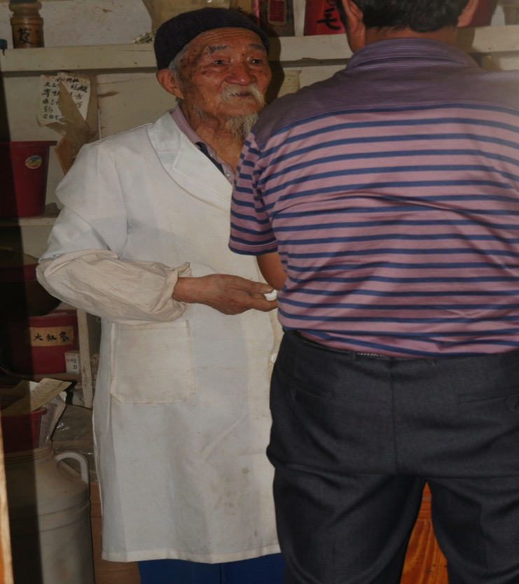
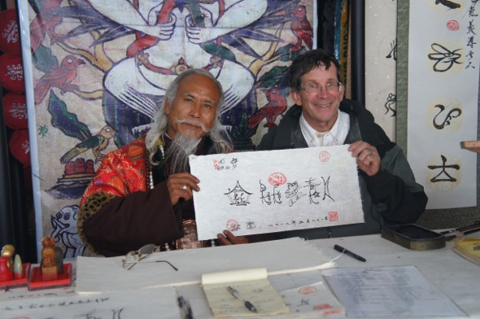
Back in the Villages, my job was to interview the local shaman and doctors about the diseases treated
Writing out his special recipe

Slide 18
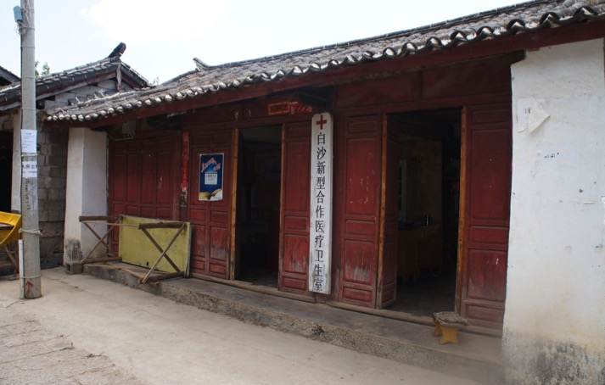
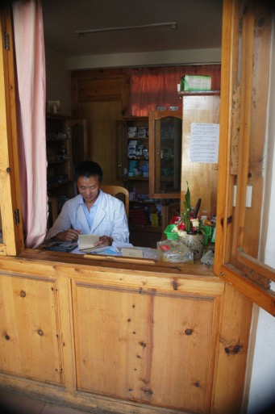
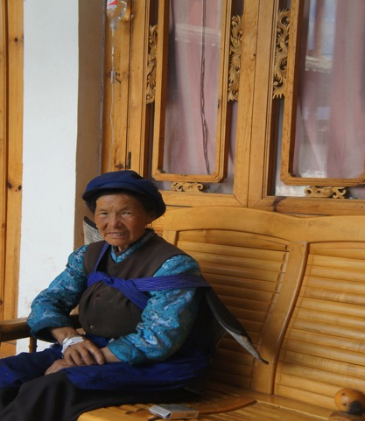
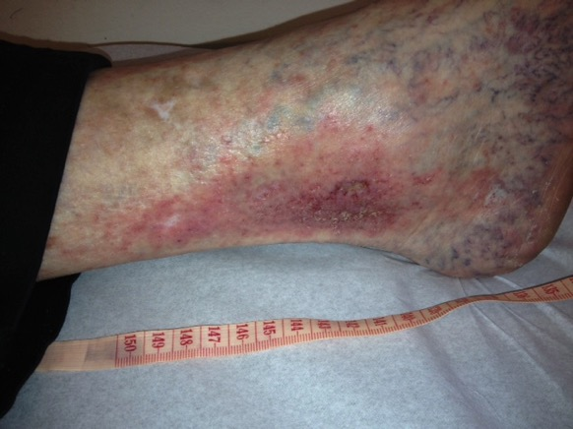
Local doctors in the villages were extremely helpful and explained the herbs they were using—such as the IV for the leg wound
Things like Hanuka honey (where bee eats toxic tetri leaves and converts to medicinal effective) were known for generations and only now discovered in West

Slide 19
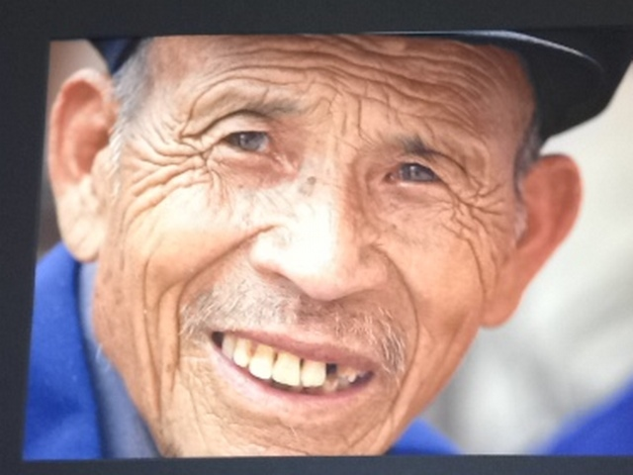
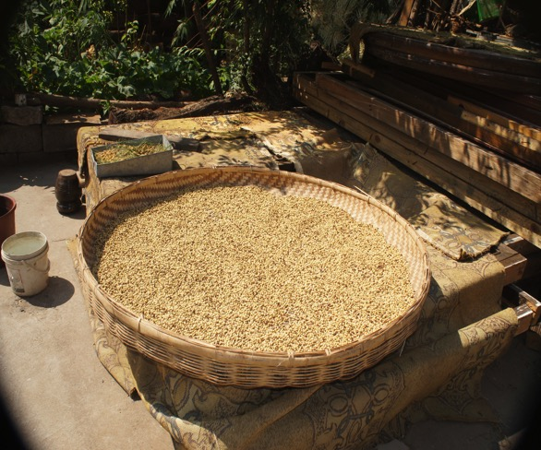
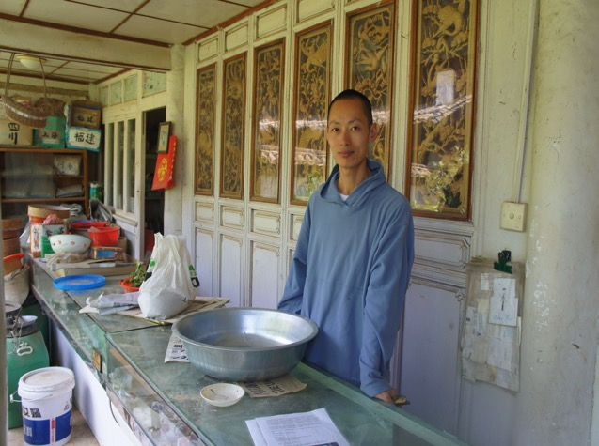
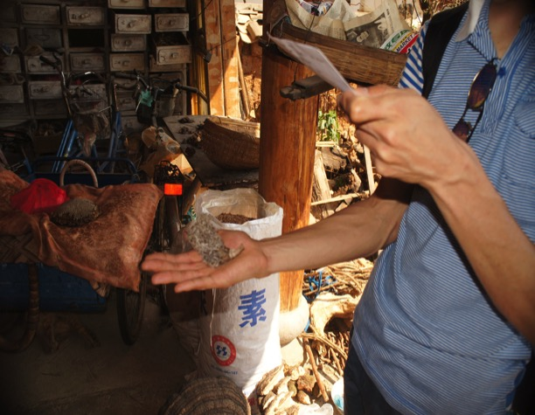
Local herbalist who
Compounded the herbs
Particular
herbal seeds
and a
collection of
Mushroom
He used
One of
Our botanists
As they get ready to compound the medicine

Slide 20
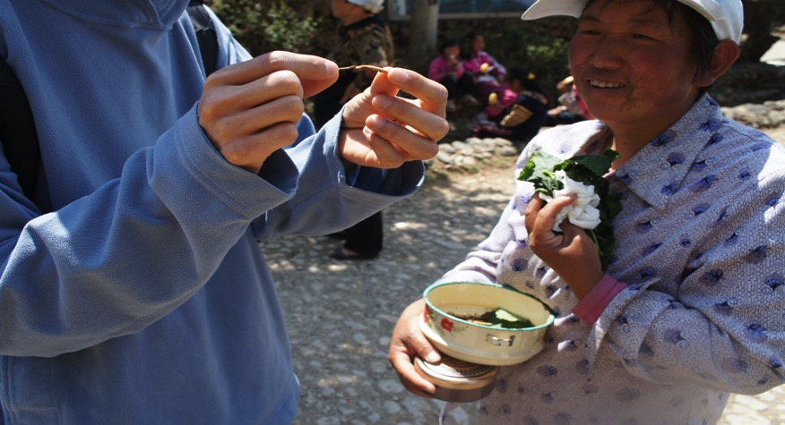
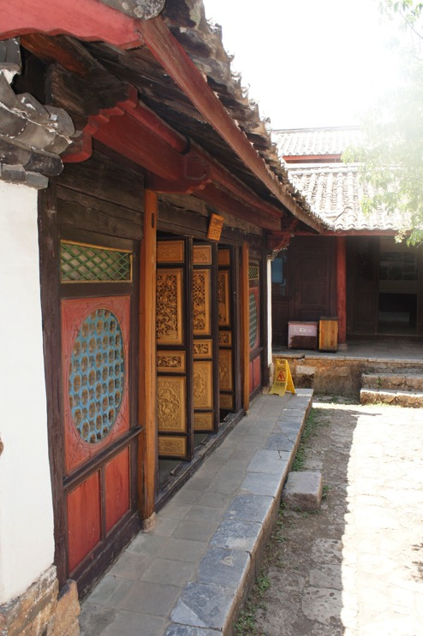
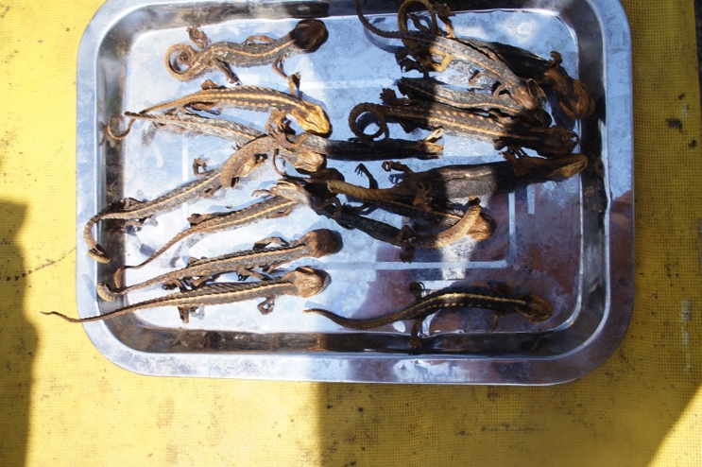
Showing us her herbs and lizards

Slide 21
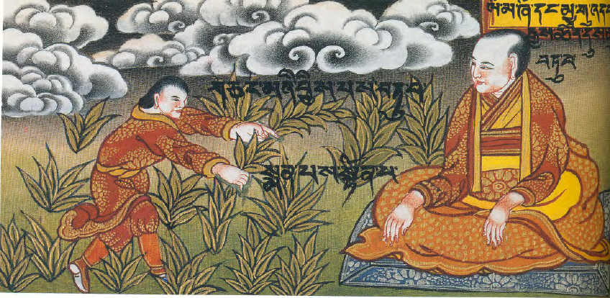
Summary: From Traditional Herbs to Throughput screening

Slide 22
Happy Birthday--Irv
Irv, thanks for not letting me quit research mixed with medicine
Thanks to Libusch, Anne, and all the fellows in Weisman lab that taught me a few tools that allowed me to escape the mouse house
Thanks to the Weissman alumni that continue to inspire me with your brilliance

Slide 24
Other projects
I am Rheumatology Editor for UpToDate—the most widely read medical textbook in the world
It is available in 140 countries and in 102 languages
With Artificial Intelligence Lab at MIT, we are adapting diagnostic algorithms in UpToDate to technology and medications available
So our goal is to train doctors and especially “shamans” to use web related resources

Slide 25
Medications usually lack “distribution”
With Beachey lab at Scripps—trying to modify common drugs (such as antibiotics) into plants that can be be brewed as a “tea”
Shaman are quite adept at “cooking” precisely
Each region has its own indigenous plants and herbs—the challenge is to maintain the ability to keep stability during extraction
We now have a division of “Needs for Underserved Children”

Slide 26
For those who want to see a few photo’s of other places

Slide 27
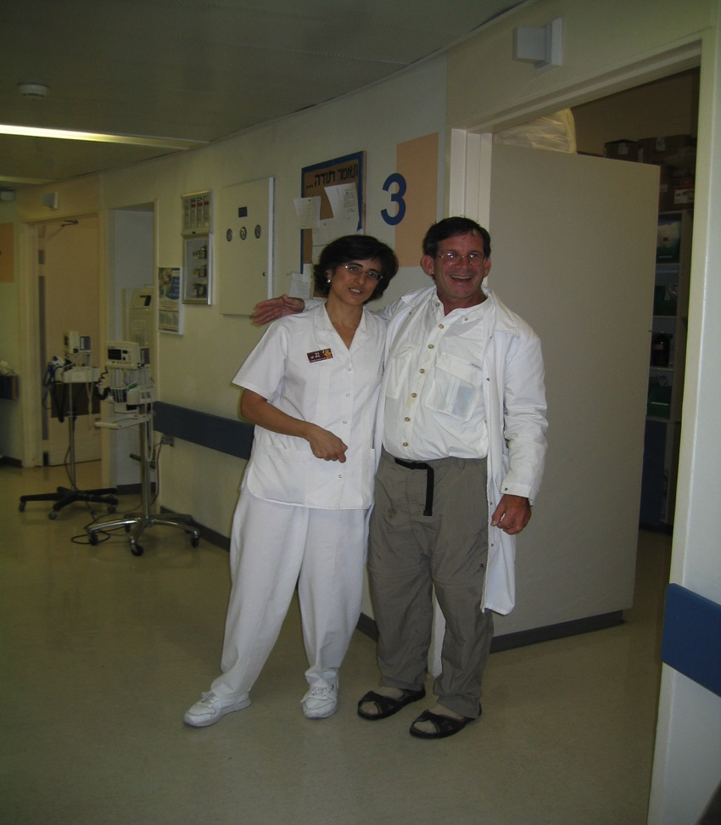
Jerusalem at height of bombing

Slide 28
Yellow names are Israeli and White are Palestinians (patients on ventilators were put on Medicine Service)

Slide 29
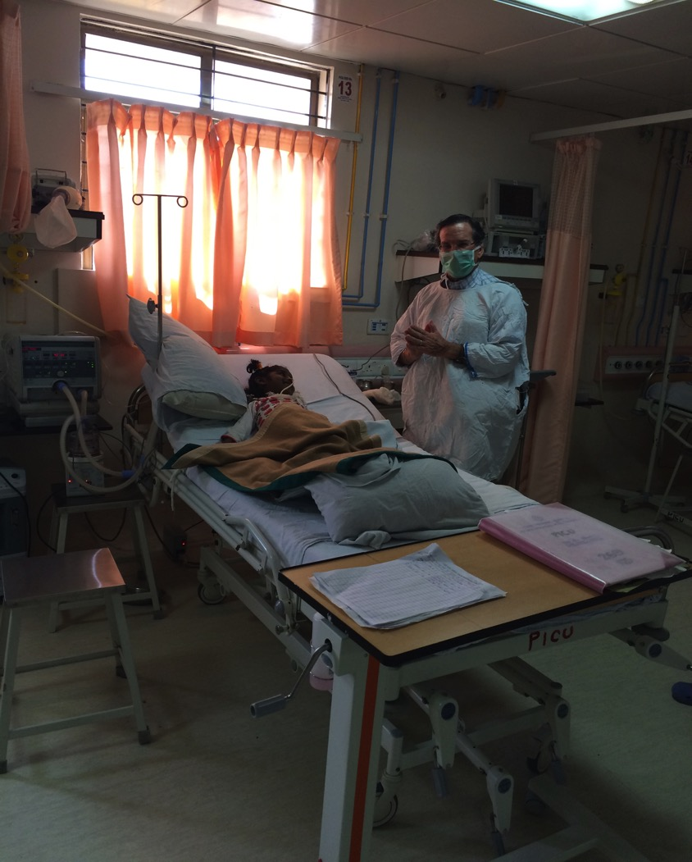
In Southern India-using PCR to check for drug resistant TBC (at RIF locus)

Slide 30
Typical Indian Emergency Room

Slide 33
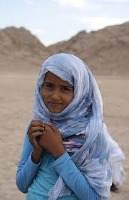
One of our helpers and the WHO director

